Slide 1




Project Wireframes
Problem statement and
solution proposal

Slide 2
Outline
The Problem
Solution Proposal
Wireframes
Next Steps

Slide 3
The Problem

Slide 4
Problem statement
State the problem you are solving in one or two sentences.
Make sure to explain why it is a real problem.

Slide 5
What customers do today
Justify your effort to try to solve the problem.
Highlight the pain points of the current solution or how customers deal with not having a solution to the problem.

Slide 6
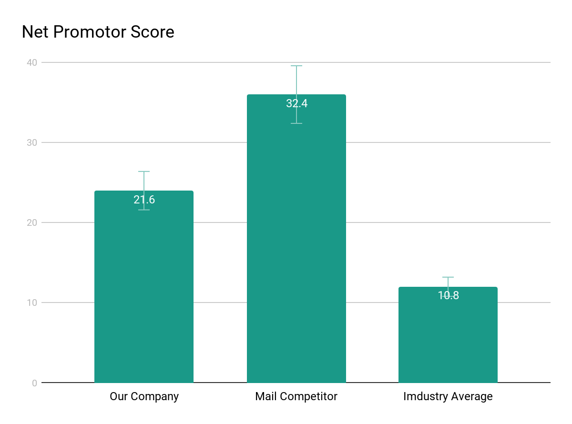
Supporting information
01
1
List any research or data you have to support the need for a solution.

Slide 7
Supporting information
02
82%
Users are constantly searching for a solution
Explain why you’re focusing on a particular part of the problem or a particular subset of users.

Slide 8

Supporting information
03
Julia
Team Manager
Reference your personas, if you have them.
Describe the content of Julia’s job and the problem she and her team are currently facing.

Slide 9
Use cases / user stories
Use cases, user stories, notes to set up the wireframes. Such as…
“As an Administrator, I would like to restrict permissions based on role.”
“As a Moderator, I would like to flag and approve comments.”
Executives indicated that being able to see a summary of each segment of data was their #1 priority.
Note: secondary admin workflow not planned for this release.

Slide 10
Assumptions
State your assumptions or any unknowns here.

Slide 11
Solution Proposal

Slide 12
Tokenization
Now that you’ve justified your attention to the problem, summarize your solution in one or two sentences.

Slide 13
Tokenization and Feature Extraction
Eliminate non-english words, punctuation mark and stop word etc.
Compute the occurrence frequency of unigrams and bigrams in twitter reviews.
Use Tf-Idf method to evaluate how important is a word in a document and select top 1000 words with the highest frequency.

Slide 14
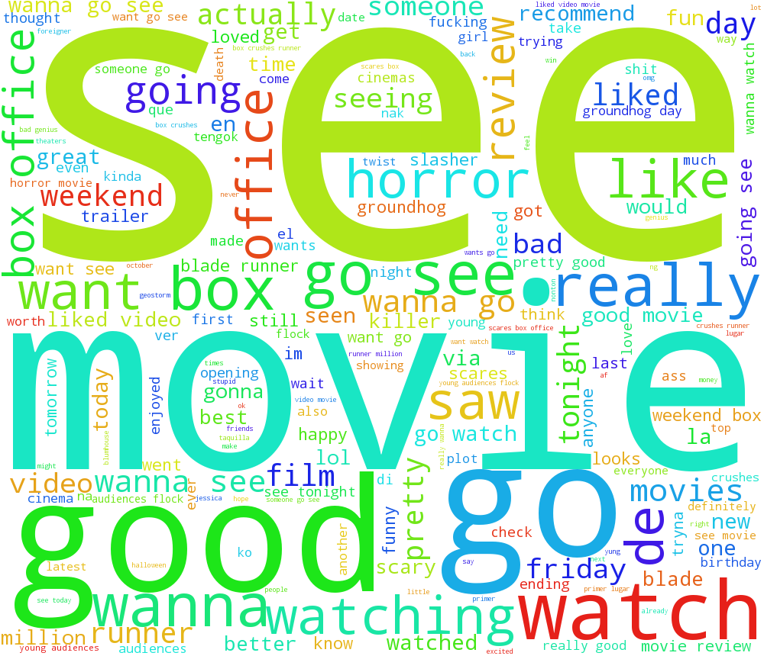
Word Cloud

Slide 15
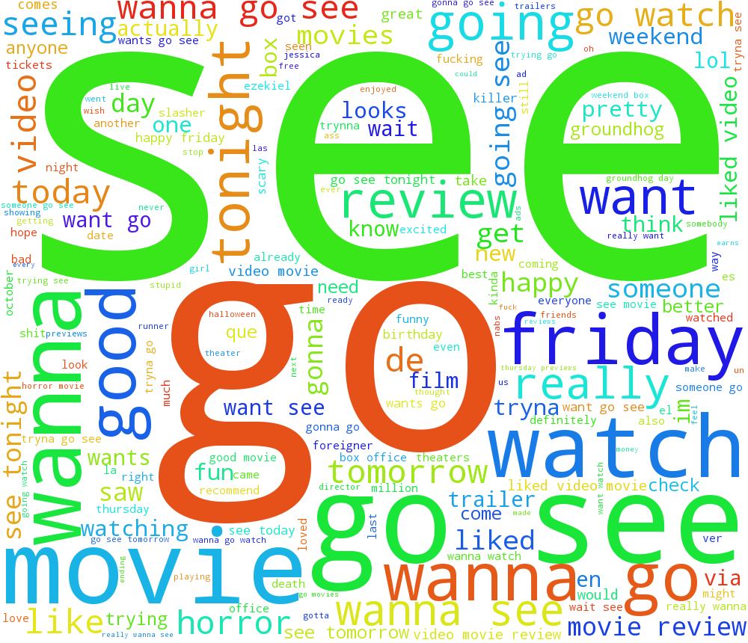
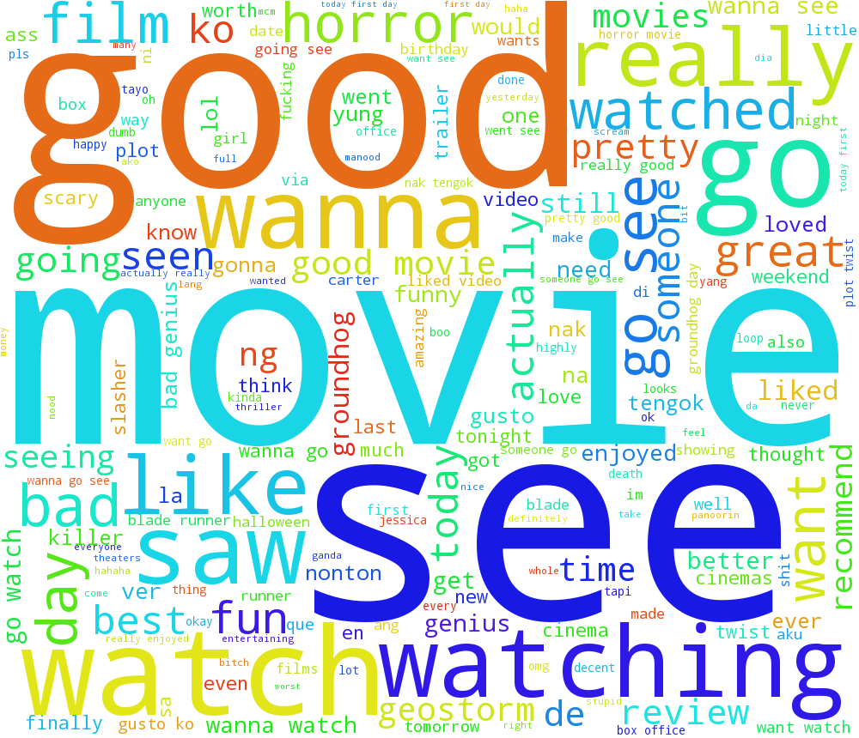
Changes of twitter topics
2017/10/13
2017/10/22

Slide 16
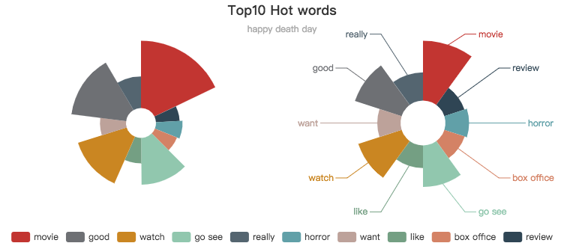
Hot features

Slide 17
Hot features trends

Slide 18
Wireframes

Slide 19
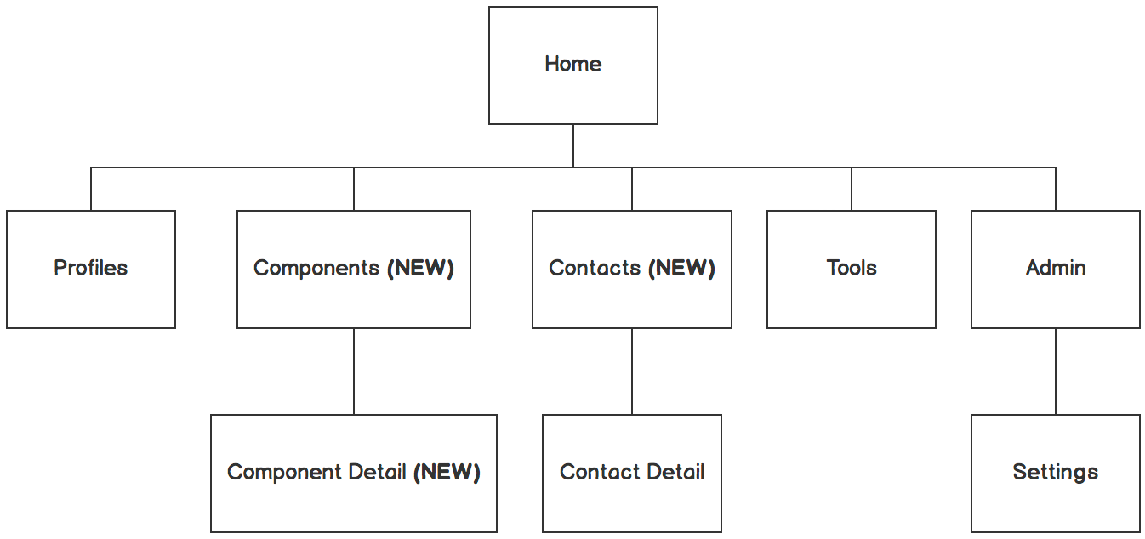

Information architecture
Balsamiq Tip | Information architecture is the flow of content across the site or application (more info).

Slide 20
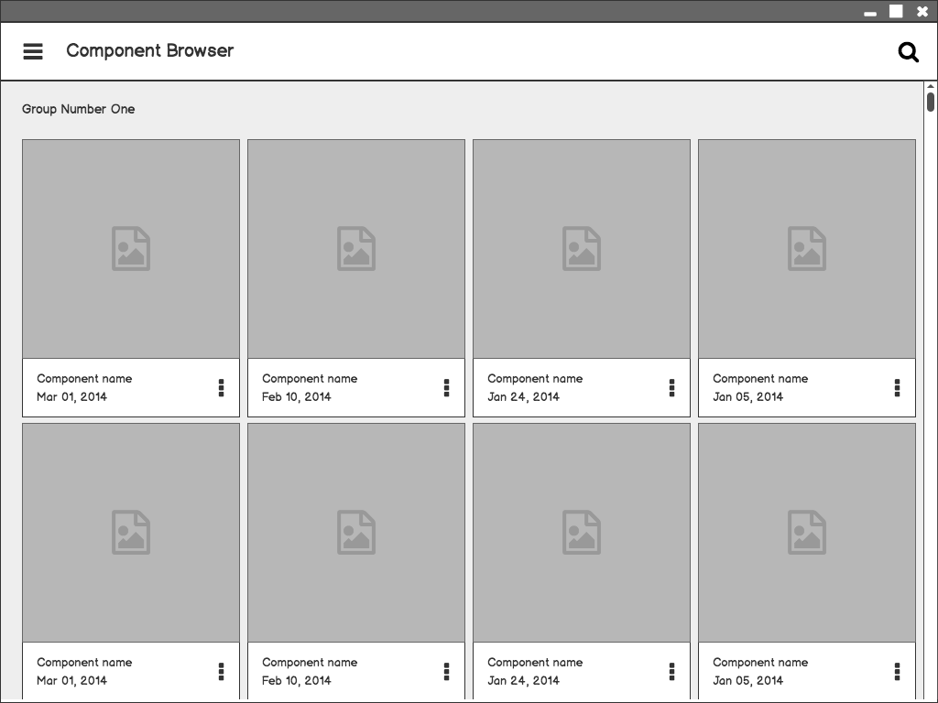
Component Browser
Call out key parts of the UI
Balsamiq Tip | Use the Balsamiq add-on to make your own wireframe.

Slide 21
Component Detail

Slide 22
Component Detail (Mobile)
Articulate your design decisions by adding justifications

Slide 23
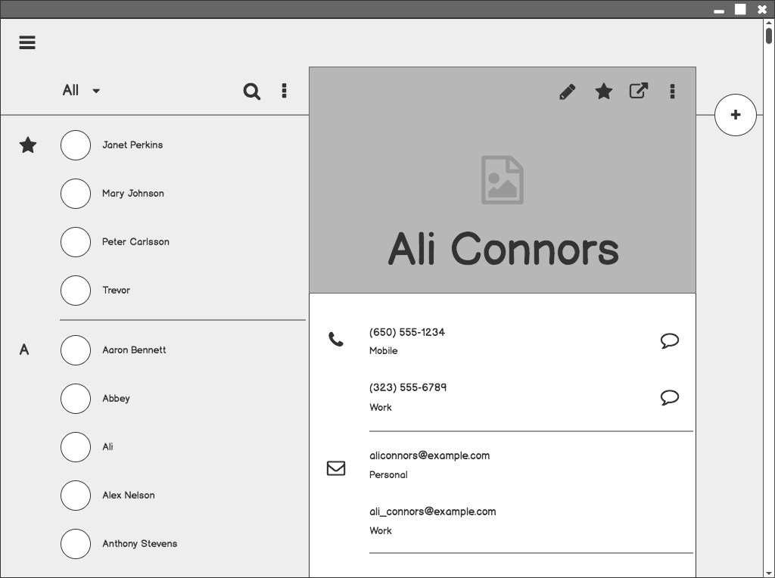
Contacts

Slide 24
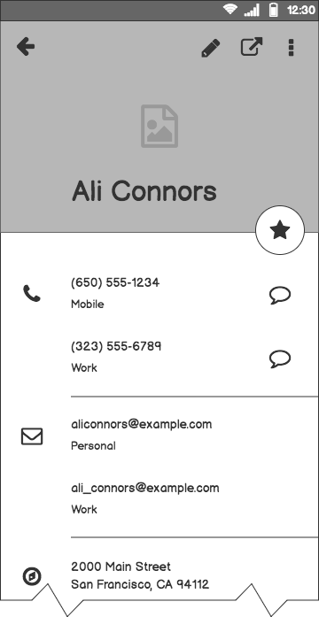
Contacts (Mobile)

Slide 25
Next Steps

Slide 26
What next?
Present the timeline.
Solicit comments on these slides or reviews on these wireframes in the Balsamiq add-on.
User testing plan.

Slide 27
Timeline
MAY
JUN
TODAY
AUG
SEPT
OCT
NOV
Requirements gathering
User research
Wireframes
Review
Prototype
User testing
Dev hand-off

Slide 28
Questions?

Slide 29
References
Tips for Presenting Your Wireframes
3 Steps to Better UI Wireframes
Wireframing for Beginners

